Slide 1
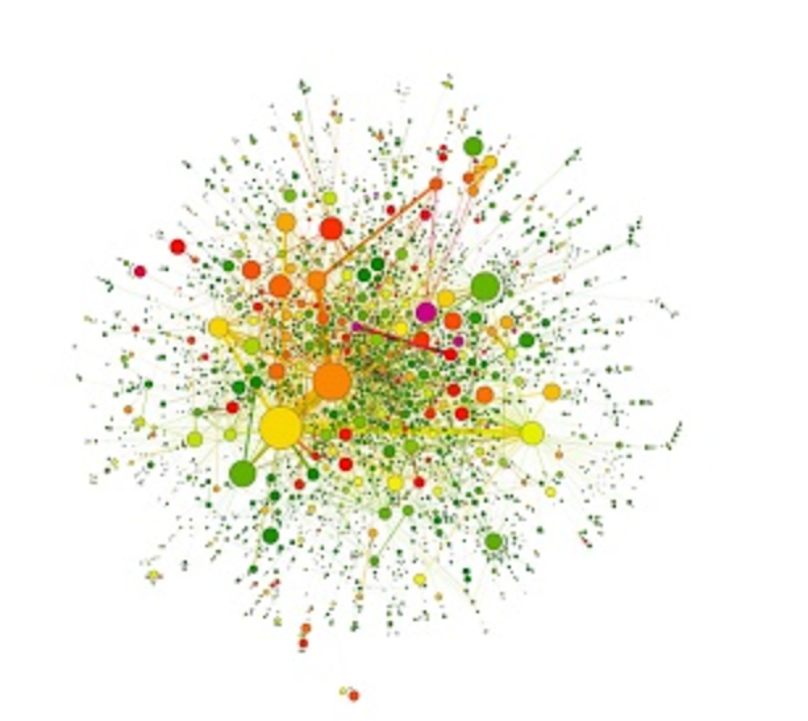
P(egs) bioinformatics
Postgraduate Evolution and Genomic Science Lecture series.
Notes:
Hello everyone! Welcome to the first Pegs seminar of 2020. For anyone who has not attended one of these before – this is a seminar series established in response to us becoming aware of a need for more bioinformatics training for postgraduates across the university. The series is organized and facilitated by PhD students in the division of Evolution and genomic science, with support from RA’s and postdocs in the divisions of EGS and Data Science. It is not designed to teach you everything you need to know, rather it is a very basic introduction to what you could do to help with your research, and some tips for where to go to find out more. We would like to thank Simon Hubbard (head of EGS) for once again backing the series, and being incredibly supportive towards us running them.

Slide 2
Hi! I’m Alex!
Alexandra Martin-Geary, Research Associate, Griffiths-Jones lab.
(Main interests: Heritable disease, Viruses, Parasites, Molecular evolution)
@Alextremophile

Slide 3
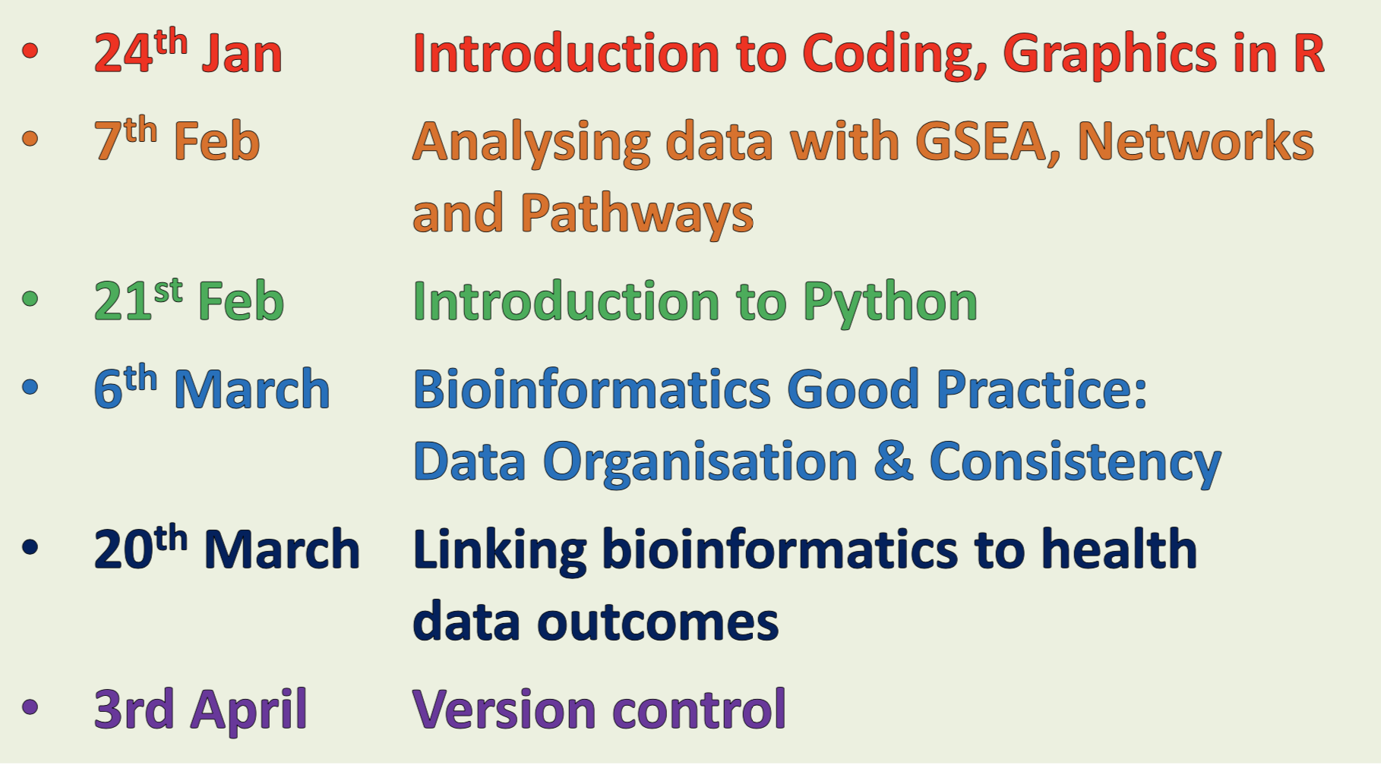
P(egs) lectures
Six Lectures - Every other Friday, 3pm
Notes:
This is how the series is shaping up for this run. There are 3 seminars which will touch on aspects of coding this year. Firstly using R, which I will get to shortly
Secondly with Python which Martin will be delivering on the 21st
And thirdly Version control, which uses some command line coding, which Mark will be going through with you on the 3rd of April. Because of this, we have decided to start the series with a primer on coding basics to lay the foundations for what will come next.

Slide 4
https://github.com/JoWatson2011/P-egs_Seminars
Notes:
Don’t worry if you miss something from today, or any of the other presentations – they will all be made available on the github repository which you can access via this link (which is also provided on the posters that are up around the department).

Slide 5
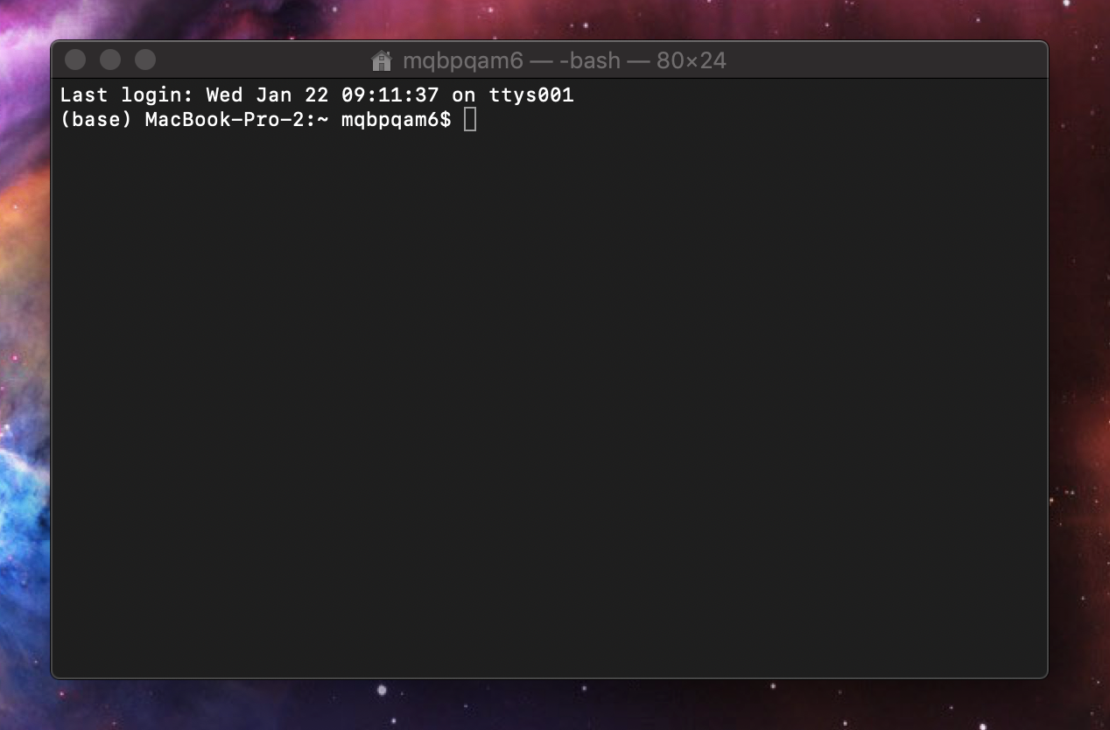
This is a Terminal window
Notes:
In case you’ve not encountered one before – this is a terminal window. It is also known as the command line, or shell, and can be found by typing either “CMD” or “Terminal” into the search function in your computer (in much the same way as you might search for word or Excel) If you’ve not used the terminal before it can, understandably seem very daunting.
I blame Hollywood, as most people’s experience of terminal windows is informed by movies, and involves either catastrophically damaging your computer, or performing some sort of illegal activity!
Sure both of these things are possible, but incredibly unlikely as, firstly - there are a huge amount of failsafes built in to protect your computer from you (notably, the need to enter a password before doing anything too major), so breaking it is more difficult than you would imagine, and secondly, I am going to assume none of you are attending this series to further your careers in crime!

Slide 6
Simple navigation
The commands that you need to enter may be different depending on whether you are using a Mac or PC.
Ls/dir
Cd
Mkdir
Rm-r/rmdir
More
Notes:
The commands that you need to enter may be different depending on whether you are using a Mac or PC.
Here I am going to provide you with a basic list of five commands, and what they do. Where the commands differ between operating systems, the red version is Mac, and the Blue is PC, otherwise they are shown in green. These commands are in a ‘language’ called bash script, which is a play on the name of the creator (who, for those of you who are fans of the Marvellous Mrs Maisel – worked at Bell labs which is featured in the series)

Slide 7
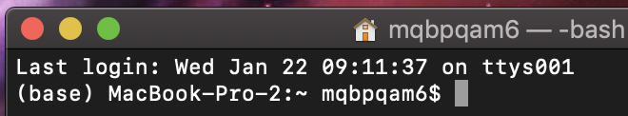
How do you know that your computer is ready to receive a command?
Notes:
Before you start, you need to know your computer is ready. Thankfully it will tell you!

Slide 8
How do you know that your computer is ready to receive a command?
The dollar sign $ means it is ready to go!
Notes:
In the terminal, the presence of the dollar sign means it is ready to go. The information before it tells you where you are currently located.
As a gentle introduction to programming, we are going to use some simple commands to find our way around the insides of my computer! (for those of you not at the session, the next few slides were supplemented by a live demonstration)

Slide 9
Command 1
ls/dir
Notes:
Imagine your computer is a big old house. When you open the terminal it is like opening the front door. You step through it, and see that you are in the hallway.
The ls/dir command lets you see what else is in the room, or more accurately the directory (or folder) you are currently in.
From the hallway you can get to the stairs, the dining room and the bathroom.

Slide 10
Command 2
Cd
Notes:
CD – or “Change Directory“
We want to go to the dining room, so we type “cd Dining_room” (actually, as there is nothing else in this folder that begins with “D” we can just type D, then hit tab and it will auto-fill the rest in for us! You will notice that I have used an underscore instead of a space this is because, with most programming languages, the computer reads spaces as the end of a command. You can get around this by enclosing the name with spaces in quotes i.e. “Dining room” but it is much easier to just replace spaces with underscores in file names.

Slide 11
Command 3
mkdir
Notes:
Using ls we look around the room – we seethe doors to a cupboard, and the kitchen, but as it’s a dining room there is something fundamental missing – a table! Using mkdir we are going to create a new directory, and call it table – we do this by entering - mkdir table. When we look around now, we can see a table!

Slide 12
Command 4
rm -r/rmdir
Notes:
We use the cd command again and make our way to the kitchen, there we find some spilled milk.
Now we are pretty advanced tech wise these days, but as far as I’m aware, we are not yet at the point where we can actively make a computer cry – so we are instead going to clean up the spilled milk by removing the directory (this works on files too).
To do this, we type “rm –r Spilled_Milk”

Slide 13
Command 5
More
Notes:
With the kitchen clean we can move to the next room. I am currently eating for two, so I use ‘cd’ to head to the pantry
Using ‘ls’ I can see that, rather than a folder, there is a file stored in here, and that file is called recipe.
This is what I have been trying to get to while seemingly aimlessly wandering around the house, but now that I am here I need to know how to read the recipe. To do it I will use the “more” command which will display the text from a file in the terminal window. When I type “more recipe.txt” it will show me my quick recipe for potato farls!

Slide 14
Quick fire!
cd Dining_room/Kitchen/Pantry/Recipe.txt
cd Dining_room\Kitchen\Pantry\Recipe.txt
Notes:
This was pretty long-winded but as you become more confident you can combine locations to make what is called a “file path”. Shown here are the Mac and Windows paths to get to the recipe. This is really helpful, because you often need to point programs you are writing to other locations in your computer, which you can do by providing the correct file path.
You can combine more than just file names this way, and make the beginnings of what we call scripts, or your first programs!

Slide 15
Other resources
https://www.makeuseof.com/tag/mac-terminal-commands-cheat-sheet/
http://www.cs.columbia.edu/~sedwards/classes/2015/1102-fall/Command%20Prompt%20Cheatsheet.pdf
Notes:
If you are new to coding it can be a real confidence boost to get to grips with using the terminal.
Here are some extra resources you can go away and practice with, once again red for mac and blue for windows. This is a very basic introduction, but will help you get a feel for how the computer “thinks” and responds, which is a foundational building block for coding. Once you are more confident you can start stringing commands together and doing more with them, and you will feel like a wizard! Now that we have covered those areas we will move on to making some pictures using code – this time in a different environment, using the language “R”

Slide 16
Introduction to R
Introduction to programming languages R and Python and their use in basic bioinformatics (in particular the rise of the GUI!)
Notes:
R is a programming language, but don’t let that put you off!
You don’t need to be a coding wizard in order to get great grahics, you just need to understand the basics!

Slide 17
Introduction to R
Datatypes – character, numeric, integer, complex and logical
Data Structures –
1. Atomic vector: items of any type
2. List: a list of items of different types
3. Table: Can have different data types
4. Matrix: 2D, same data types
5. Array: 3+D, same data types
Notes:
Different ‘types’ of data are called specific things. It is important to know what types of data you are dealing with, as the program will interpret and use them in different ways.
Characters are words, or ‘strings’ of characters, such as ‘Alex’ or ‘Alex Samira and Jo’.
Numeric data is data made up of whole numbers such as ‘1’ or ‘897’.
Integers are numbers with decimals such as ‘1.8’ or ‘897.4357689’.
Complex numbers involve algebraic notation/symbols such as ‘1+2i”.
Logical data is the result of a comparison between two values and will result in an output of TRUE or FALSE, for example 2=2 is ‘TRUE’.
You can find more about it in this useful tutorial: http://www.r-tutor.com/r-introduction/basic-data-types
Data structures are the way in which your data is stored. I like to imagine them as shapes.
An atomic vector is a single value that you have stored. For instance, if I were to want to store the number four, I could create an object ‘FOUR’ and store the number 4 in it. When I ask R what ‘FOUR’ is, it will tell me that it is an atomic vector, of numeric type. Atomic vectors can be any type you like as they only contain only one thing.
A list is exactly that – a list of items. Lists are very like a column you might see in excel. Each of the cells can have a value of the same, or different type in it. E.G. 1,2,3,4,5,6 would be a list of numeric type.
A table is a selection of data which has one or more rows and columns. Each value within a column must be the same type, but different columns can have different types. For example, if I have some data representing flowers, it might have the following columns: Flower name, Number of petals, and length of stem, each of which would be a different type of data.
A matrix is very like a table, only all the data within it has to have the same type. These types of structure are incredibly useful when you are doing statistics as often you will need to have a set of numeric data wherein the values can each be compared with the other.
Finally an Array is a set of data with 3 or more dimensions where all of the data is of the same type. These are complicated data structures that can be used for more complicated multi-dimensional plotting such as networks.

Slide 18
Introduction to R
3) What is R/R studio
How is it not excel?
R, Huh, good god y’all - What is it good for? (Stats and Graphics)
Notes:
R is a lot more versatile and reliable than excel. When you are dealing with very large data excel can struggle, loose rows or simply not load the whole set. R however is able to take in all of your data, and thanks to the ability to download and use other people’s code as packages, you can make a much larger number of beautiful plots, simply by mixing your data with their code!

Slide 19
Introduction to R
4)Graphics
Bar, line, scatter, bubble, violin, heatmap, trees, pca, network, sankey, maps, timeseries, etc etc…
https://www.r-graph-gallery.com
Notes:
There are lots of awesome things you can do in R, so many in fact that it can be difficult to choose the best plot type for your data (especially if you don’t know what plots are available to make!)

Slide 20
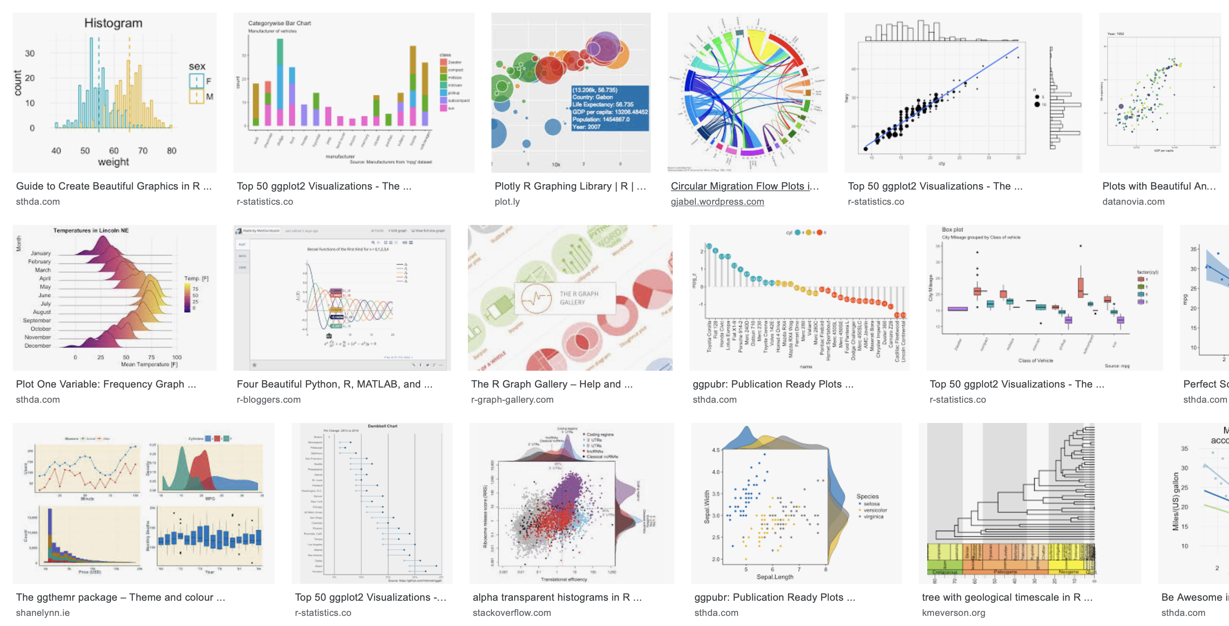
“Beautiful R plots”
Notes:
As a quick example, this is what I get when I type “Beautiful R plots” into a google image search!

Slide 21
What we will be looking at today:
Topic 1 – Basic Data analysis (Counts, averages, basic stats)
Topic 2 – Simple Graphics (Bars, scatters and lines)
Notes:
These are the basic topics we will be covering in the first part of this lecture.

Slide 22
The Iris dataset (Get used to it – you will see it a LOT!)
>iris
Sepal.Length Sepal.Width Petal.Length Petal.Width Species
1 5.1 3.5 1.4 0.2 setosa
2 4.9 3.0 1.4 0.2 setosa
3 4.7 3.2 1.3 0.2 setosa
4 4.6 3.1 1.5 0.2 setosa
5 5.0 3.6 1.4 0.2 setosa
Notes:
This is the iris dataset. It is on of the example datasets that is built in to R. You can see it by typing ‘iris’. The greater than symbol is what R puts at the beginning of every line to show that it is ready to receive a new command. If the > symbol isn’t at the start of your line when you want to type in a new command, it probably means that the program is still busy working on the previous command you gave it.

Slide 23
The Iris dataset (Get used to it – you will see it a LOT!)
>iris
Sepal.Length Sepal.Width Petal.Length Petal.Width Species
1 5.1 3.5 1.4 0.2 setosa
2 4.9 3.0 1.4 0.2 setosa
3 4.7 3.2 1.3 0.2 setosa
4 4.6 3.1 1.5 0.2 setosa
5 5.0 3.6 1.4 0.2 setosa
Notes:
The numbers on the left hand side aren’t actually in the data – they are an addition from R to help you refer to each row. This is useful because sometimes you will want to take a subset of data by choosing only rows 2,3 and 4 for example.

Slide 24
The Iris dataset (Get used to it – you will see it a LOT!)
>iris
Sepal.Length Sepal.Width Petal.Length Petal.Width Species
1 5.1 3.5 1.4 0.2 setosa
2 4.9 3.0 1.4 0.2 setosa
3 4.7 3.2 1.3 0.2 setosa
4 4.6 3.1 1.5 0.2 setosa
5 5.0 3.6 1.4 0.2 setosa
Notes:
These are your column names. In the iris dataset R already knows that these names aren’t supposed to be included in the main data, instead they are a useful way to say which column you are looking at, for example if I wanted to know the mean sepal width I could type mean(iris$Sepal.Width) – this way the program knows I want the mean of ‘iris’ data, column ‘Sepal.Width’.
If R didn’t recognise Sepal.Width as the title of the column it wouldn’t be able to calculate mean as it would try to include ‘Sepal.With’ in the calculation… which wouldn’t work as its not a number! When you are loading in your own data you need, therefore, to let it know if your columns have titles or not (I will show you how later).

Slide 25
The Iris dataset (Get used to it – you will see it a LOT!)
>iris
Sepal.Length Sepal.Width Petal.Length Petal.Width Species
1 5.1 3.5 1.4 0.2 setosa
2 4.9 3.0 1.4 0.2 setosa
3 4.7 3.2 1.3 0.2 setosa
4 4.6 3.1 1.5 0.2 setosa
5 5.0 3.6 1.4 0.2 setosa
Notes:
This is the main data that will actually get used when you ask R to do things.

Slide 26
Types of R user software
Base R: No frills coding environment
R-Studio: Much more user friendly (Will demo in today’s lecture)
Plotly (https://plot.ly/create/#/)
Notes:
Base R is the no-frills programming language, in this there is only one viewing window, you can only see your data if you call it up, and any plots you make open in a popup. It is very much no nonsense, but is also more difficult for the average beginner to use.
R-studio is a lot more user friendly (it needs base R to have been installed on your computer in order to run). It has lots of buttons and options and mini windows, and is a lot more akin to excel in its user-friendliness!
Plotly is an online tool developed by a Canadian company. It is very user friendly, however, and plots you make are publicly available for anyone to look at. Obviously this isn’t ideal if you are doing sensitive research. This isn’t the end of the world however – once you are used to the types of data and their shapes you can make ‘toy’ versions of your data to use in plotly. Using ‘toy’ or face data you can make the type of plot you want, then copy the R-code plotly makes and paste it into R-studio, putting the real data in place of the ‘toy’ data you used in plotly. This way you get a lot of the useablity, with greater security.

Slide 27
R-Studio
R studio
Autofill! (super helpful!)
Viewing windows (Base R doesn’t have this)
Lots of buttons!! (More buttons than Sharpe!)
Notes:
These are just some of the reasons to love R-studio!

Slide 28
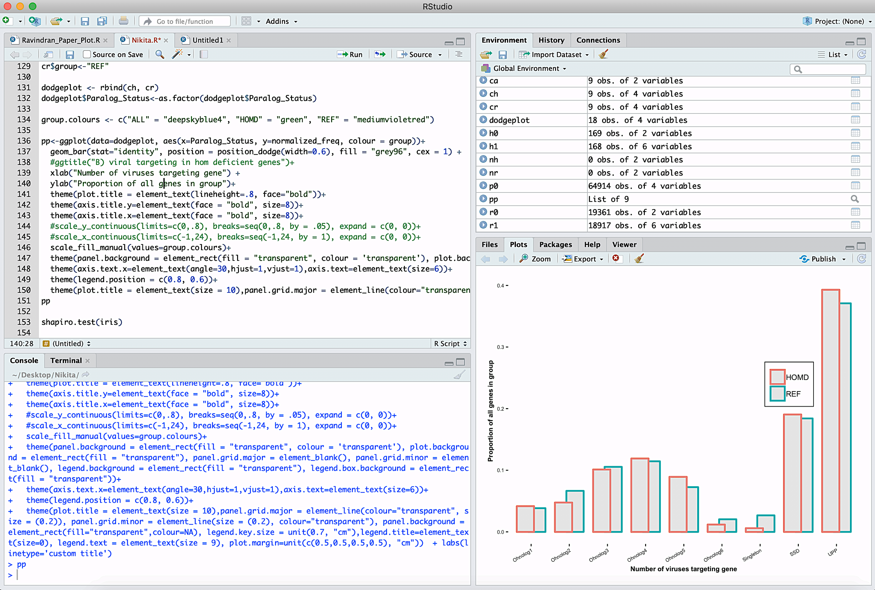
R studio
Notes:
This is a text editing window. You can use it to write and save your code (sort of like a word file) before you run it.

Slide 29
R studio
Notes:
This is the running window and the the ‘run’ button. When you are done writing your code you can highlight the bit you want to run in the text editing window and hit this button – your code will appear in blue in the bottom window when it has run. You could also copy paste your code into the bottom window and hit return, or type it in to this window manually – but the easiest option is to just highlight it and hit run!

Slide 30
R studio
Notes:
This window shows you all of the data you have uploaded, what type of data and structure it is, and what you have called it. (this is really useful for keeping track of things). You can also look at your data by clicking on it, or using the tabs at the top.

Slide 31
R studio
Notes:
This is where your plots appear! You can scroll through them by clicking the forwards and back buttons.

Slide 32
Loading in data and packages
A package is like an update, but you choose to install it rather than it being forced on you!
Sometimes packages mask each other, so watch out for warnings
Everyone’s R is unique, like a fingerprint!
Loading files: knowing where to look
Loading files: Understanding file-types
Storing things in ‘variables’
Notes:
Packages are code that has been written by members of the R community that do different jobs. They are super useful because they have done the hard work so you don’t have to. Once you have downloaded the package you want you just have to load it in, then R will know how to do whatever it is that package was built to do. Remember – you only have to download it once, but you will need to load it in every time you want to use it.
To download the package ggplot2 (the best graphics package) you would write:
install.packages(“ggplot2”)

Slide 33
Loading in data and packages
rm(list= ls())
library(tidyverse)
library(plyr)
#Load data
setwd("/Users/alex/Desktop/")
v0 <- read.csv("Alex_sheet_analysis.csv", header = T) [c(13)]#Path to Data
Notes:
This is a basic set of code that loads in the packages tidyverse and plyr (both very useful), then gets a file of my data that I have saved on the desktop of my computer.

Slide 34
Loading in data and packages
rm(list= ls())
library(tidyverse)
library(plyr)
#Load data
setwd("/Users/alex/Desktop/")
v0 <- read.csv("Alex_sheet_analysis.csv", header = T) [c(13)]#Path to Data
Get rid of any residual data from last session
Notes:
This is super important- R remembers what you did in your last session. If you want to start from a clean slate you have to wipe the recent memory in R, this stops any previously loaded packages or data interfering with the analysis you want to run now.

Slide 35
Loading in data and packages
rm(list= ls())
library(tidyverse)
library(plyr)
#Load data
setwd("/Users/alex/Desktop/")
v0 <- read.csv("Alex_sheet_analysis.csv", header = T) [c(13)]#Path to Data
Tell it which packages to install
Notes:
Once you have cleared the memory, you need to load the packages you want to use from your library of downloaded packages – this is how!

Slide 36
Loading in data and packages
rm(list= ls())
library(tidyverse)
library(plyr)
#Load data
setwd("/Users/alex/Desktop/")
v0 <- read.csv("Alex_sheet_analysis.csv", header = T) [c(13)]#Path to Data
Tell it which folder you want to use for your analysis
Notes:
Setwd means set working directory – this tells R that the place in my computer that I want to use is my desktop. Once I have told it this, R will look in this location for the data I want to load, and will save any any output to this location too.
If I wanted to look in a folder called “R_stuff” on my desktop instead, I could type
setwd(“/Users/alex/Desktop/R_stuff/”)

Slide 37
Loading in data and packages
rm(list= ls())
library(tidyverse)
library(plyr)
#Load data
setwd("/Users/alex/Desktop/")
v0 <- read.csv("Alex_sheet_analysis.csv", header = T) [c(13)]#Path to Data
Name the container that your data will be stored in
Notes:
Here we are telling R that we want to create a storage container in which to keep our information called v0. The arrow pointing at v0 indicates that whatever follows will be put into the new container.

Slide 38
Loading in data and packages
rm(list= ls())
library(tidyverse)
library(plyr)
#Load data
setwd("/Users/alex/Desktop/")
v0 <- read.csv("Alex_sheet_analysis.csv", header = T) [c(13)]#Path to Data
Choosing the right file
Notes:
Here we are telling it the name of the file we want to import. If you haven’t set the working directory (you don’t have to) then you would need to tell it the full location of the file here (e.g. “/Users/alex/Desktop/Alex_sheet_analysis.csv”). One of the reasons I like the setwd command is that it means you don’t have to repeatedly type out the whole location of thing s if you want to load/save multiple files that are all in the same place.

Slide 39
Loading in data and packages
rm(list= ls())
library(tidyverse)
library(plyr)
#Load data
setwd("/Users/alex/Desktop/")
v0 <- read.csv("Alex_sheet_analysis.csv", header = T) [c(13)]#Path to Data
Telling it how to read the file (what format)
Notes:
The characters after the dot in your file name are very important as they tell R what sort of file you are giving it, and how it should be read. There are many different types of file, here are a few:
.csv = comma separated values (each value is separated by a comma)
.txt = a text file, the values are generally separated by either spaces or tabs – you should always try and avoid having spaces within your values as it can lead to R thinking it is a separator when reading it in, the best way is to make your values contain underscores rather than spaces.
.tab = a tab separated file.
As you can see, here we are telling it that this is a comma separated value file, we have also said this at the beginning of the line by telling it to read a csv (read.csv())

Slide 40
Loading in data and packages
rm(list= ls())
library(tidyverse)
library(plyr)
#Load data
setwd("/Users/alex/Desktop/")
v0 <- read.csv("Alex_sheet_analysis.csv", header = T) [c(13)]#Path to Data
Giving it a bit more info
Notes:
When we talked bout letting R know if your column has names this is what I meant. Here I am saying that headers equals true (my data does have column titles). If my data didn’t have titles, and I set headers to T R would use the first row of data instead – this is bad as it would be omitted from the analysis. If my data didn’t have column titles, I would want to write header = F here instead.

Slide 41
Loading in data and packages
rm(list= ls())
library(tidyverse)
library(plyr)
#Load data
setwd("/Users/alex/Desktop/")
v0 <- read.csv("Alex_sheet_analysis.csv", header = T) [c(13)]#Path to Data
Giving it a bit more info
Notes:
I have decided not to use all my data, so have added this instruction at the end. What this tells R to do is only load column 13 in. the result therefore will be that v0 contains one column of information.

Slide 42
Loading in data and packages
rm(list= ls())
library(tidyverse)
library(plyr)
#Load data
setwd("/Users/alex/Desktop/")
v0 <- read.csv("Alex_sheet_analysis.csv", header = T) [c(13)]#Path to Data
Commenting for your own sanity!
Notes:
To help you remember what your code does you can make notes that R wont read and get confused about. To do this you type a # symbol, anything that follows it will be ignored when running your code.

Slide 43
Simple things you can do
Counts using plyR/DplyR
Why count (see your data)
What counting can do for you (basis of many plots)
How do you do it
> t1<-count(iris, c("Species"))
> t1
Species freq
1 setosa 50
2 versicolor 50
3 virginica 50
Notes:
PlyR and dplyR are super useful packages that help you learn more about your data. One of the most useful things they can do is ‘count’. Here we are asking it to count the number of entries for each species in the iris data, store that information in a contatiner (t1) then show me thee contents of the container by typing its name. If we wanted to make a count of how many of each species had each sepal width we would write count(iris,c(“Species”,”Sepal.Width”)) instead.

Slide 44
Finding Averages
What are the mode, mean and median?
How do we find them?
> colnames(iris)
[1] "Sepal.Length" "Sepal.Width" "Petal.Length" "Petal.Width" "Species"
> median(iris$Petal.Length)
[1] 4.35
> mean(iris$Petal.Length)
[1] 3.758
> getmode <- function(v) {
+ uniqv <- unique(v)
+ uniqv[which.max(tabulate(match(v, uniqv)))]
+ }
> t2 <- getmode(iris$Petal.Length)
> print(t2)
[1] 1.4
Notes:
Here we want to know what the columns ar called so we can ‘call’ them in our statistical tests by using the command ‘colnames()’. We put the name of the container that our data is stored in inside the brackets to tell colnames() where to look for the columns we are interested in. It then prints out the name of the columns to the screen.
Now that we know the column names we can request the median() and mean() by putting the data.name$column.name that we want in the brackets.
Mode doesn’t have a simple premade test in R so we have to write our own ‘function’. To do this we make a container, in this case called “getmode” for code instead of data (we can use this over and over again if we want). We are telling it that the type of code this is is a function and that it will work on some data, which it will call ‘v’. It will find all the unique values in the data ‘v’, then figure out how many instances there are of each, and which is the most common. We could write this all on one line, but by adding the + sign at the beginning of the row we are saying we havent finished yet, and that R needs to keep reading the next line as if it were all on the same line, this helps the code stay a little more reader friendly!
We then use this function on our data, storing the result in a variable by typing t2<-getmode(iris$Petal.Length)
We can the print it out by either typing t2, or more explicitly print(t2).

Slide 45
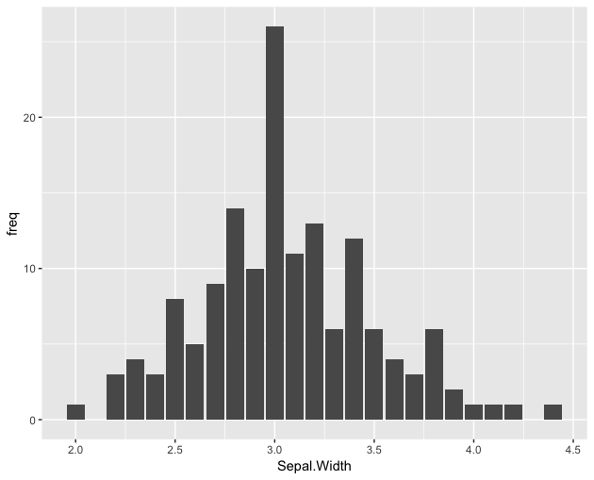
Basic plots
#Make a new count to plot
t3 = count(iris, c("Species", "Sepal.Width"))
ggplot(data=t3, aes(x=Sepal.Width,
y=freq))+
geom_bar(stat="identity")
Notes:
The next few slides will show you the code you need to make some basic plots. If you want to use your own data you just need to substitute the iris data for your own.
Here we are counting how many of each iris species has each sepal width and storing the results in a variable ‘t3’. We then use this information to build a plot!
Here we are just using the basic ggplot package, but if you want to experiment with ggplot2 there is a lot more you can do!
We are telling it that we want to make a plot using ggplot, the data ‘t3’, the X axis will be the different Sepal widths and the Y axis will be the number of times each one occurs (or the frequency) that was generated when we counted the data in the previous step. We then tell it we want a bar chart by writing geom_bar, and we want to use the values as they appear within t3 (and not modified statistically in any way) by typing stat=“identity”.

Slide 46
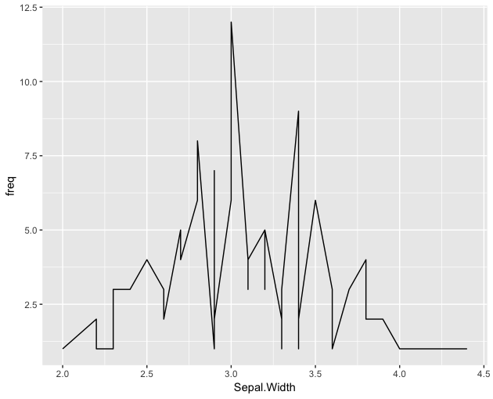
Basic plots
#Make a new count to plot
t3 = count(iris, c("Species", "Sepal.Width"))
ggplot(data=t3, aes(x=Sepal.Width,
y=freq))+
geom_line(stat="identity")
Notes:
Here we are doing exactly the same as in the previous slide, but instead of geom_bar to get a bar chart, we have written geom_line so the resulting plot will be a line graph.

Slide 47
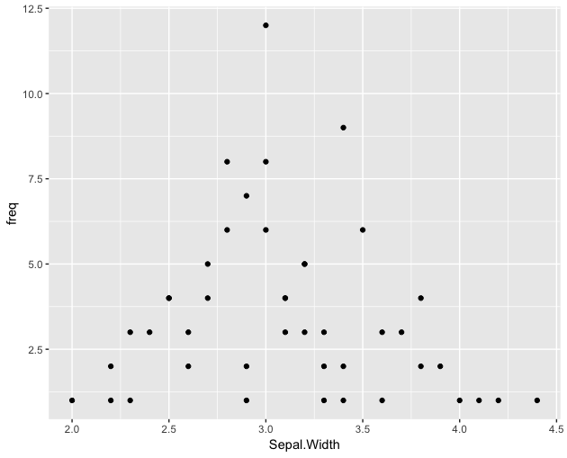
Basic plots
#Make a new count to plot
t3 = count(iris, c("Species", "Sepal.Width"))
ggplot(data=t3, aes(x=Sepal.Width,
y=freq))+
geom_point(stat="identity")
Notes:
Once again, this is exactly the same as the last two plots but instead we have written geom_point to give us a point, or scatter plot!

Slide 48
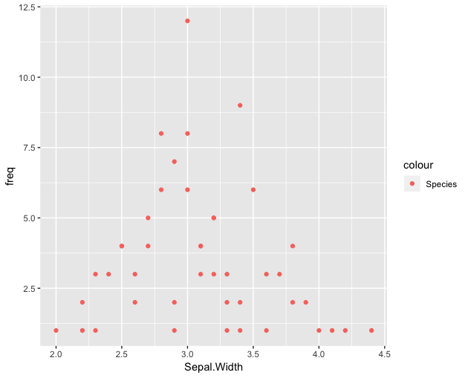
Changing colours
ggplot(data=t3, aes(x=Sepal.Width, y=freq, col="red"))+
geom_point(stat="identity")
Notes:
Now that we know how to make the three most common plot types we can modify them a little.
Here we have added the col= instruction after telling it which data to use. This quite simply tells it that rather than the automatic colour that R normally chooses, we want it to use a colour of our choice – in this case red. There are lots of different colours to choose from, the best way to find out what the options are is to search for images of “ggplot colours” online.

Slide 49
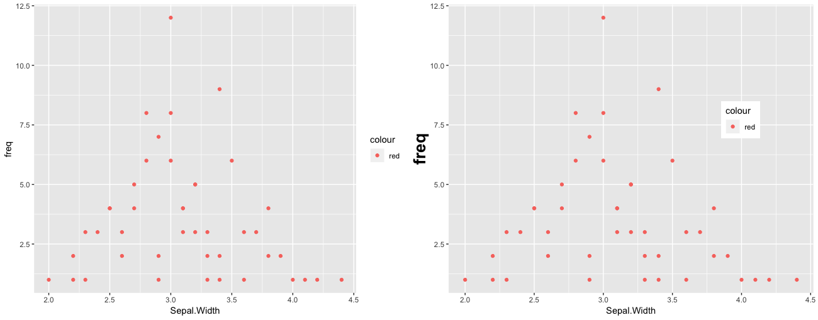
More things you can do
Shifting legends
Changing text size
Grouping plots
Notes:
Now that you have the basics down it only takes a word or two to start personalising your plots.

Slide 50
More things you can do
Shifting legends
Changing text size
Grouping plots
Notes:
Here we have changed the size of the axis title, and the location of the legend . We have also grouped two plots together side by side so they can be called together as one image.

Slide 51
A brief intro to R
What we have covered today:
1 – Introduction to some coding basics
2 – Simple Data analysis in R
3 - Simple Graphics

Slide 52
Today’s R code:
https://github.com/JoWatson2011/P-egs_Seminars/tree/master/2019/1_GraphicsUsingR
Notes:
For all the R code from today, plus some extra statistics that I presented in the last session go to the 2019 github via this link. Once you have R studio installed you should be able to load it up and run/modify it to play about with R yourself!

Slide 53

Where you can get more information
A Bioinformatician’s best friend!
The ‘Statistics using R’ book (from the library)
http://www.r-tutor.com/r-introduction
https://www.r-graph-gallery.com
https://towardsdatascience.com/using-networkd3-in-r-to-create-simple-and-clear-sankey-diagrams-48f8ba8a4ace
https://www.jessesadler.com/post/network-analysis-with-r/
https://www.statmethods.net (Quick R)
Fundamentals of Data Visualisation by Claus Wilke

Slide 54
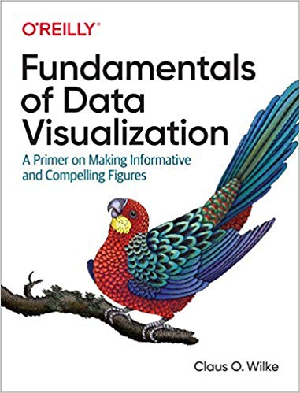

Slide 55
Thank You!
We would like to say a big thank you to the Division of Evolution and Genomic Science for supporting this series, and all of you for attending!
Please join us for drinks and chat in the café!

Slide 56

Thank you Hadley Wickham!
‪@hadleywickham‬

